Slide 1
IEEE SC VP of Finances AdCom Report
Stephen M. Holt
Washington, DC, USA
30 August, 2019

Slide 2
Budgetary Actions Accomplished in 2019
IEEE Action Requested | Date Due | Action | Status
Page Counts due from S/Cs | April 2019 | ISJ page count set at 4,000 for 2019 and 4,500 for 2020; J-MASS page count for 2019 was set at 300 and for 2020 it is 450 | Closed
Capital requests due from S/Cs | April 2019 | No action required | Closed
Renewal Product Offerings from S/Cs | May 2019 | Used to provide input for our membership dues and publication (pricing and issues, media type) issues which changed since last year. | Closed
Target Budgets Sent to S/Cs | June 2019 | Target budgets are built based on assumptions. Assumptions include using historical trends, pub rates, and input from MSD (Marketing) for Pub revenue. The file includes prior year actuals, current year’s budget and the target view. | Closed

Slide 3
Budgetary Actions Accomplished in 2018
IEEE Action Requested | Date Due | Action | Status
First Pass Target Budgets Due from S/Cs | June 2019 | The view that reflects updates from SC. Worked with VP of Conferences to gather 2020 conference budget details. Estimated revenue and expense details for each event were provided in the First Pass. MOUs were completely approved before contributions were recorded. | Closed
Executive Management Review of IEEE Budget | July 2019 | Management Council reviews First Pass and discusses changes for Second Pass | Closed
Second Pass Budget Revisions Incorporated | Early August 2019 | IEEE requested any final changes to the 2020 Firstpass budget. In most cases, S/Cs do not provide input. There are small changes due to updates from IEEE Publications, TAB, and MSD that are automatically incorporated in Second Pass. August YTD reports from IEEE need to be posted as of early Sept 2019. | Closed

Slide 4
Budgetary Actions Accomplished (Con’t)
IEEE Action Requested | Date Due | Action | Status
Second Pass Review by IEEE FinCom | August 2019 | Second budget from this organization. | Open
TAB FinCom Endorsement | September 2019 | TAB FinCom will hopefully approve 2nd pass during their 21 September meeting | Open
IEEE FinCom Endorsement | September 2019 | Final budget approval from this organization | Open
IEEE Board of Directors Approval | November 19/20 2019 | The final approved version of the budget for the given year | Open

Slide 5
Some Additional Information to Consider

Slide 7
“Science Systems Engineering” - A Definition
Science Systems Engineering - “Signifies the analysis of a scientific research problem in all its dimensions, even before developing the instrumentation. Starting with a clear definition of the problem, we would design instruments capable of obtaining the necessary data, then plan how these data would be analyzed, determine what errors might occur because of the intrinsic limitations of the instruments, and define the expected statistical weights of the observations. Only when it was clear that crucial results could be obtained would we proceed with the project. The principles of science systems engineering would be applied throughout the lifetime of the project to ensure that no changes occurred that would jeopardize its scientific success. – Dr. Riccardo Giacconi, 2002 Noble Laureate in Physics, “Secrets of the Hoary Deep”

Slide 8
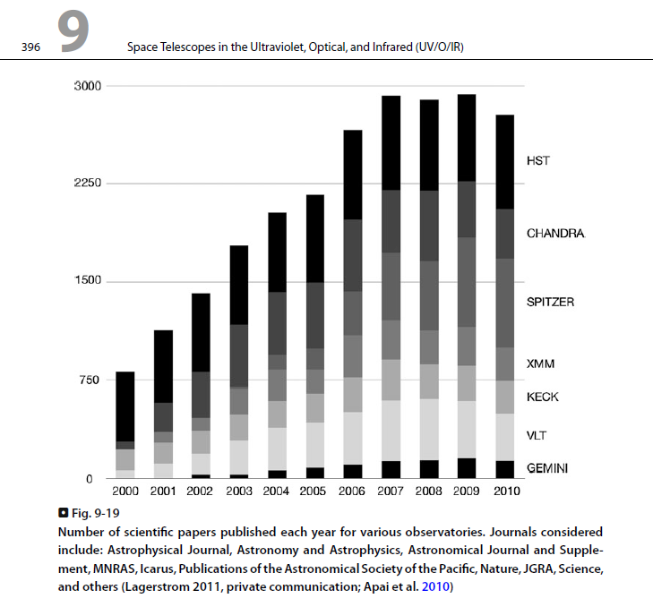

Slide 9
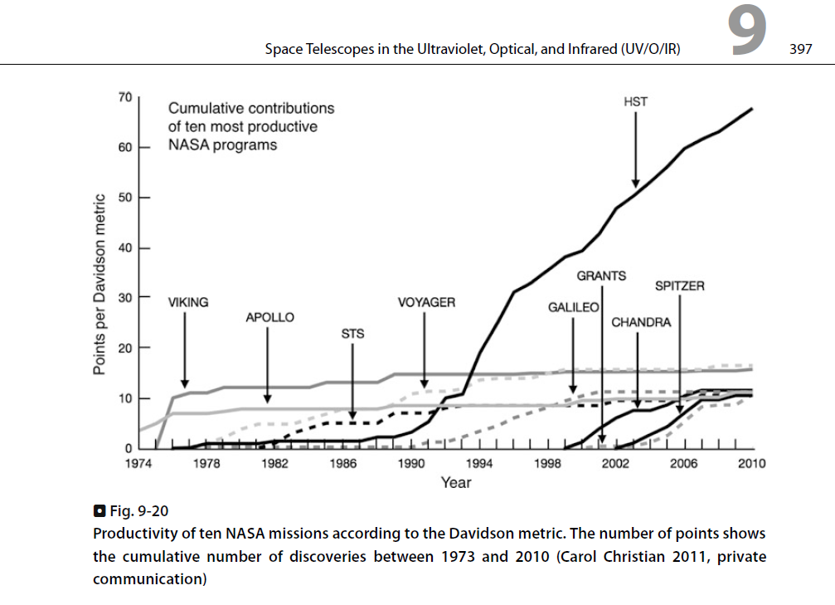

Slide 10
References
Systems Engineering for Astronomical Telescopes, SPIE Press, 5 April 2018, 4 ISBN: 9781510616547 (and Tutorial Presentation) – Note: Source of A-Train “SOS” slide.
Planets, Stars and Stellar Systems, Vol 1, Telescopes and Instrumentation, Springer Science and Business Media Dordrecht 2013, ISBN 978-94-007-5620-5, Chapter 9, Space Telescopes in the Ultraviolet, Optical, and Infrared (UV/O/IR), Mario Livio et al (Space Telescope Science Institute, Baltimore, MD, USA) – See figures 9-19 and 9-20. Also, R. Giacconi’s analysis of «Science Systems Engineering» here.
Secrets of the Hoary Deep: A Personal History of Modern Astronomy, Riccardo Giacconi, John Hopkins University Press, 2008, ISBN-13: 978-0801888090.
Apai, D., Lagerstrom, J. P., Reid, I. N., et al. 2010, PASP, 122, 808.
Christian, C. A. (STScI), & Davidson, G. (Northrop Grumman), 2006, in ASSL, 335, Organizations and Strategies in Astronomy, Vol. 6, ed. A. Heck (New York: Springer), pg. 145, ISBN-13: 978-1402040559 – Note: Number of stories in Science News magazine (https://www.sciencenews.org/) that feature a significant discovery by a given mission. Note: ISBN-13: 978-1402040559. Note: Full paper at: https://link.springer.com/chapter/10.1007/1-4020-4056-3_11

