Slide 1
Young Professional Report – Fall 2019
James Ritchie III
IEEE Systems Council Young Professional Representative
IEEE Young Professionals Global Taskforce Member

Slide 2
Outline
This year: IEEE Global YP Task Force
YP Face to Face – San Diego
µVolunteering update
What else have I been doing?
YP Q/A at SysCon 2019
How can the IEEE Systems Council help?

Slide 3
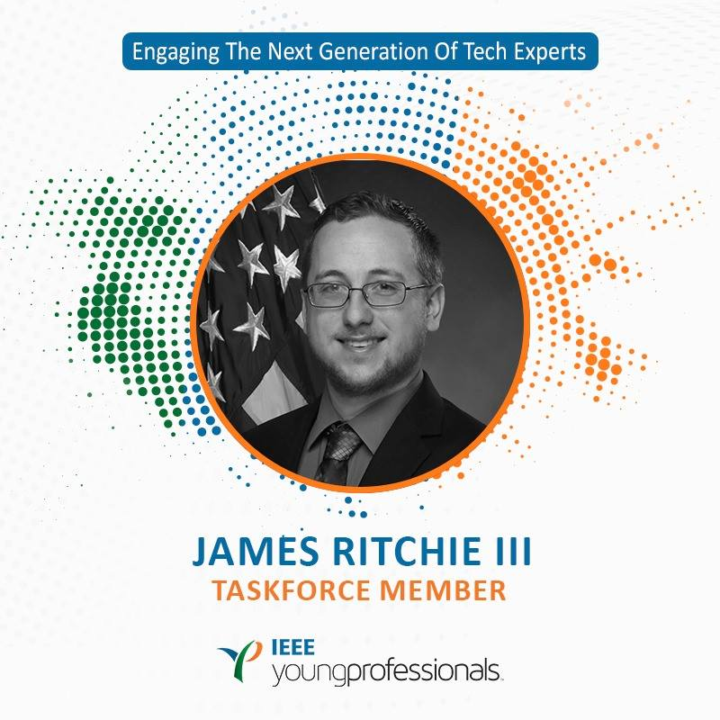
This Year: IEEE Young Professionals Global Task Force
The IEEE YP Group reports to the BoD
Has representation from MGA and TAB
Diverse group
Develops business plan for YP
Manages the Funding Portal for YP events
Promotes marketing for YP
Works with BoD on new initiatives involving YPs

Slide 4
My tasks in Global YP Task Force
Manage Funding Portal https://yp.ieee.org/funding-portal/
Maintain website – https://yp.ieee.org/
Discuss new business plan goals
Support µVoltuneering
Assist in communications

Slide 5
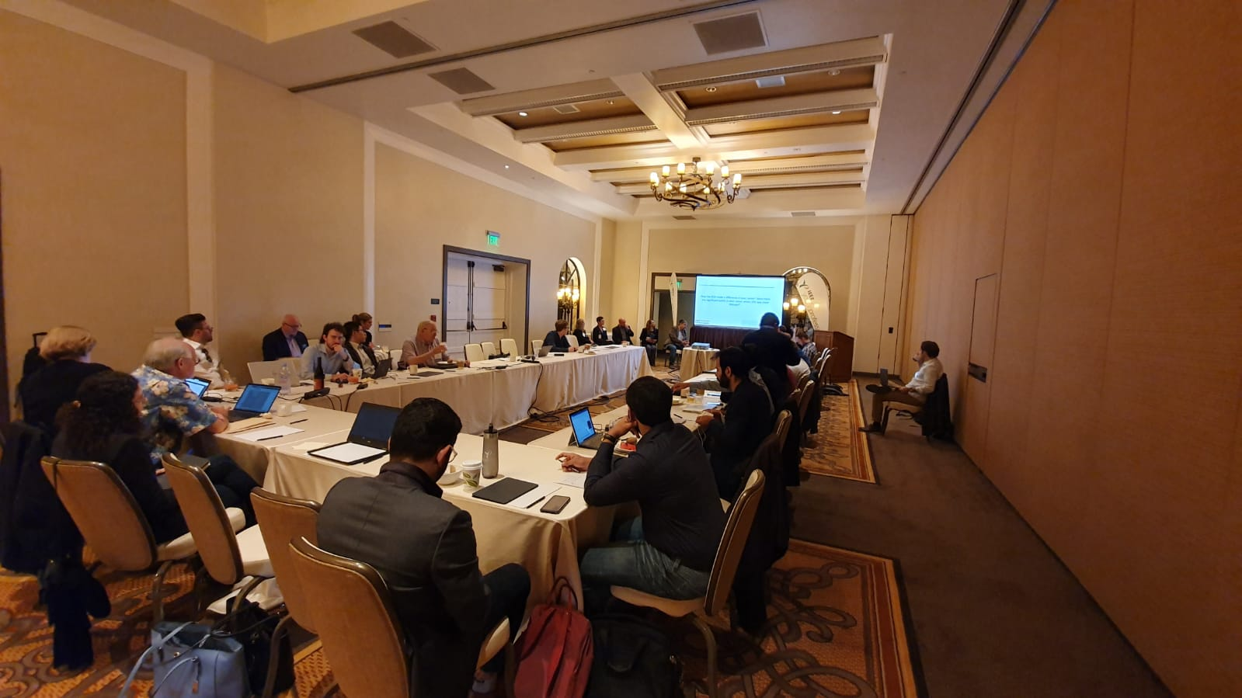
IEEE YP Face to Face Meeting – San Diego
2-day meeting
Discussed current business plan progress
µVoltuneering pilot progress
Loyalty program
Senior membership elevation
Funding events
Discuss new goals for the upcoming business plan
Hosted a debate
Killed IEEE Xplore Flex
Discussed voting power of YPs
Updated manuals to help new YPs

Slide 6
IEEE YP Face to Face Meeting – San Diego
Motion 1: The IEEE Young Professionals committee recommends that every technical society and council must have a Young Professional representative. - Voting: Unanimous
Motion 2: The IEEE Young Professionals committee endorses the creation of an ad-hoc to perform an assessment on the current status of the IEEE Young Professionals and their future.

Slide 7
IEEE Young Professionals Business Plan Projects
IEEE Xplore YP Access
Leverage an existing IEEE service to provide IEEE Young Professional members with the technical content
µVolunteering
Introduce a platform that allows IEEE Young Professional members to create and find flexible micro-volunteering opportunities
Loyalty program
Improve members and volunteers’ experience and the feeling of belonging to the organization
Increase members engagement, recognize and track local volunteer efforts on every level
Signature & Meet Up Events
Support presence at high-profile events to expand global IEEE Young Professionals community
Attract industry practitioners and increase inter-unit engagement
Seed/Local Activity funding
Provide support for local events to increase local volunteers engagement
Build ecosystem needed to create fully sustainable YP Affinity Groups
Notes:
-7.2 Higher grade

Slide 8
What is µVolunteering?
Idea: volunteering within IEEE should be more flexible and adaptable to today’s busy lives
Making long commitments isn’t possible for some people
µV aims to increase the visibility of short-term or intermittent volunteering
Currently in a testing phase
Wraps up in December 2019 (was extended)
Limited to select number of OUs
Communications Society
Computer Society
Will make recommendation to BoD on how to proceed
Notes:
Add OUs that are related to Systems Council

Slide 9
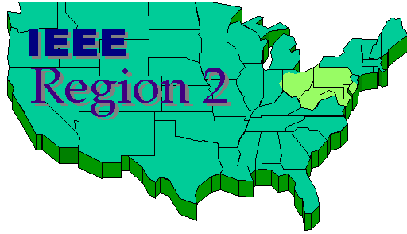
What else have I been doing?
Attend TAB YP Telecons
Assisting in updating the J-MASS website
Treasurer of Southern New Jersey Section (Region 2)
Ran YP event at SysCon 2019
Planning ISSE YP Event w/ potential collaboration with INCOSE

Slide 10
YP Q/A at SysCon 2019
Had about 18 YPs attend the event
3 people from industry on the panel
Very good conversations between the panel and YPs
Got good feedback from attendees afterwards

Slide 11
How can the IEEE Systems Council help?
Continued support for YP events
Support for the YP Rep to continue to attend the yearly TAB YP F2F summit
Support for the YP Rep to go to IEEE YP F2F Conference
Let me know how I can help your society’s YP

Slide 12
Questions?

