Slide 1
Fall 2019 Report
Jose ‘Pepe’ L Contreras-Vidal, FIEEE
Cullen Distinguished Professor
Director, NSF UH IUCRC BRAIN
University of Houston
RA Representative to IEEE Systems Council
SC/RA Representative to IEEE BRAIN Initiative
IEEE BRAIN Transition Committee Member
IEEE Roadmaps IRUG Member

Slide 2
Call for Papers
IEEE Systems Journal
Special Issue on “Translational Issues in Clinical Brain-Machine Interface Systems for Assistance, Diagnostic and Restorative Applications”
This special issue intends to highlight research in support of systems-based approaches to the improved design, validation and translation of clinical BMI systems. Topics of interest include but are not limited to:
‐ Innovative AI approaches to robust BMI design
‐ Patient screening, selection, and training
‐ Reliability, physics of failures (PoF), and health prognosis of BMI systems
‐ Interoperability and standards for clinical BMI systems
‐ Ethical, legal, regulatory, reimbursement, and social issues
‐ Diagnostic applications of BMI systems, including daily life and activity monitoring

Slide 3
Call for Papers
IEEE Systems Journal
Special Issue on “Translational Issues in Clinical Brain-Machine Interface Systems for Assistance, Diagnostic and Restorative Applications”
Important Dates:
Paper submission due date Nov 1, 2019
Completion of first round of reviews Feb 15, 2020
Revised manuscript due date April 1, 2020
Final decision notification May 1, 2020
Final version of the manuscript due August 1, 2020
Guest Editors:
Jose L Contreras-Vidal, University of Houston
James Giordano, Georgetown University
Paul Sajda, Columbia University

Slide 4
International Symposium on Wearable & Rehabilitation Robotics (WeRob 2019), Oct 16-18, 2019, Houston TX
Host Institution: TIRR Memorial Hermann
Conference Co-Chairs:
Gerard E. Francisco (TIRR, UT Health)
Jose Contreras-Vidal (University of Houston)
Marcie K. O’Malley (Rice)
Jose L. Pons (CSIC, Spain)

Slide 5
International Symposium on Wearable & Rehabilitation Robotics (WeRob 2019) http://tirr.memorialhermann.org/werob2019/
Topic Highlights:
Integration of Wearable Robots in Rehabilitation Technology
Wearable Robots for Health and Wellness in Aging
Future of Work: Maximizing Performance and Safety through Wearable Robots

Slide 6
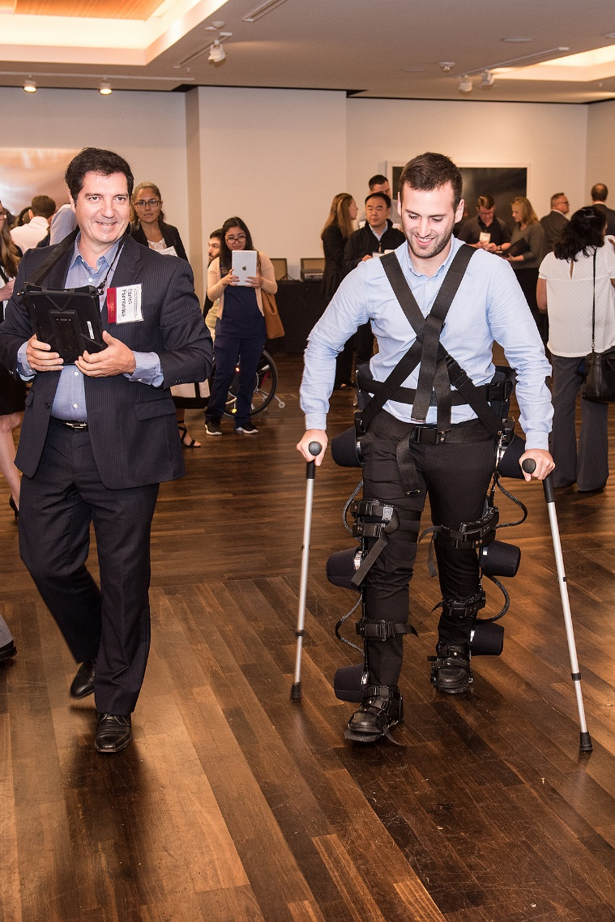
Technical sponsorship
The International Symposium on Wearable & Rehabilitation Robotics (WeRob 2019)
Technical sponsor: IEEE Systems Council
Co-sponsor: IEEE Robotics and Automation Society through the IEEE RAS Technical Committee on Wearable Robotics

