Slide 1
VP Member Services Report
2019 Fall Meeting

Slide 2
Chapter Situation at July. 2019
A total of 13 active chapters:
8 chapters only related to System Council (as before). Last chapter from Israel
5 joint chapters (were 7 before)
Most coverage from North America and Europe

Slide 3
Chapter Situation at July. 2019
A total of 13 active chapters:
8 chapters only related to System Council (as before). Last chapter from Israel
5 joint chapters (were 7 before)
Most coverage from North America and Europe
South Africa and Madras chapters without a chair.
South Africa did not make anything for 3 years will be dismissed by IEEE (Madras also did not do anything, but it was established in 2018, so there is time.)

Slide 4
System Council Chapters
Region | Location | Date of formation | Chair
8 | Italy | 2008 | Moschitta (2015)
6 | Coastal LA | 2009 | Yeh (2009)
7 | Toronto | 2011 | Tirandazian (2018)
0 | Shanghai | 2014 | Tong (2016)
8 | South Africa | 2015 | NO CHAIR
1 | Mohawk Valley | 2016 | Riley (2016)
1 | Long Island | 2016 | Lanziero (2019)
8 | UK and Ireland | 2017 | Hessami (2017)
2 | Washington | 2017 | Douglass (2018)
9 | Mexico | 2017 | Varquez (2017)
0 | China | 2017 | Zhang (2017)
8 | Tunisia | 2018 | Balkouti (2019)
0 | Madras | 2018 | NO CHAIR
5 | Galveston | 2018 | Taqvi (2018)
8 | Israel | 2018 | Mordecai (2018)

Slide 5
System Council Chapters
Region | Location | Date of formation | Chair
8 | Italy | 2008 | Moschitta (2015)
6 | Coastal LA | 2009 | Yeh (2009)
7 | Toronto | 2011 | Tirandazian (2018)
0 | Shanghai | 2014 | Tong (2016)
8 | South Africa | 2015 | NO CHAIR
1 | Mohawk Valley | 2016 | Riley (2016)
1 | Long Island | 2016 | White (2016)
8 | UK and Ireland | 2017 | Hessami (2017)
2 | Washington | 2017 | Douglass (2018)
9 | Mexico | 2017 | Varquez (2017)
0 | China | 2017 | Zhang (2017)
8 | Tunisia | 2018 | Balkouti (2019)
0 | Madras | 2018 | NO CHAIR
5 | Galveston | 2018 | Taqvi (2018)
8 | Israel | 2018 | Mordecai (2018)
5 Joint chapters; 8 System Council only
7 chapters from ‘America’ (R1,2,5,6,7,9)
4 chapters from Eu (R8)
2 chapters from Asia (R0)
The chapters without chair (R0 and R8) were joint chapters

Slide 6
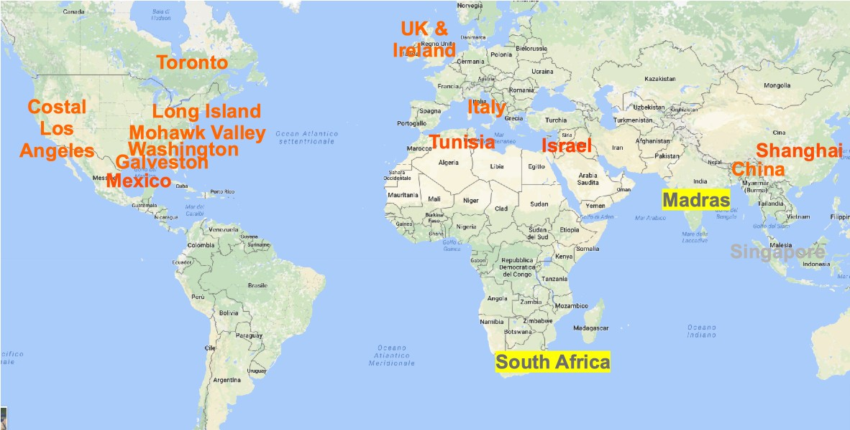
System Council Chapters

Slide 7
System Council Chapters
Most chapters chapters from ‘North America’.
Missing Chair from South Africa and India

Slide 8
System conference(s) attendance
Same results as in spring

Slide 9
Chapters vs attendance
Country | Chapters | Attendance | SysCon 2018 | SysCon 2019
USA-CAN-MEX | 6 | 304 | 57 | 85
CHINA | 1 | 32 | 4 | 0
UK | 1 | 25 | 2 | 0
ITALY | 1 | 23 | 0 | 0
MADRAS | 1 | 11 | 8 | 6
BRASIL |  | 24 | 12 | 10
GERMANY |  | 70 | 11 | 17
FRANCE |  | 29 | 5 | 4
Comments:
Clear correlation between (average) attendance and number of chapters
Germany and Brasil give a remarkable attendance without a chapter
Madras had an attendance not null
France decrease
New chapter form Israel still not providing papers

Slide 10
Germany
People from Germany attending our conferences have been contacted by Brooke, to see if anyone is willing to start a chapter. Still waiting for their response

